Slide 1
Energy Efficient Operation of 3GPP LTE-A and IEEE 802.16m Downlink Channel
Autors: Volgov Daniil and Panyshkin Andrey
Students of Samara University

Slide 2
Outline
Introduction
Methods
Experiments
Discussion
Conclusion

Slide 3
Introduction
Improving client operation period without recharging its battery, GPP LTE Advanced defines a so called Discontinuous Reception DRX mode, whereas IEEE. In what follows, we bridge in this gap by first introducing the power saving modes and then by conducting their comparative analysis.

Slide 4
Methods

Slide 5
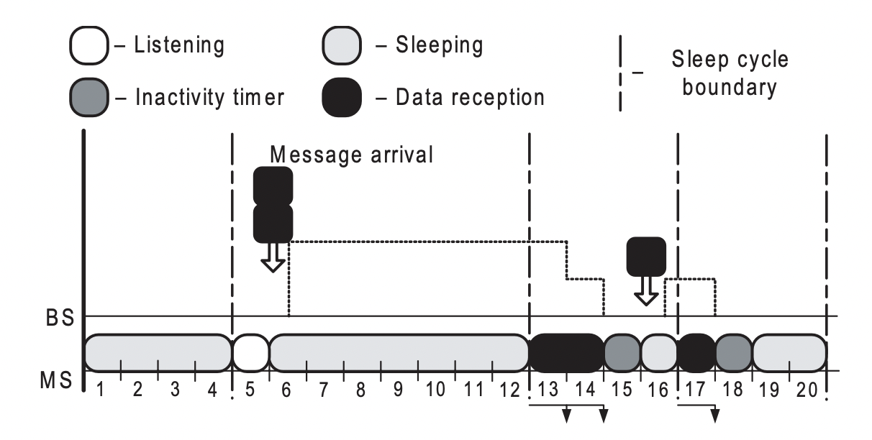
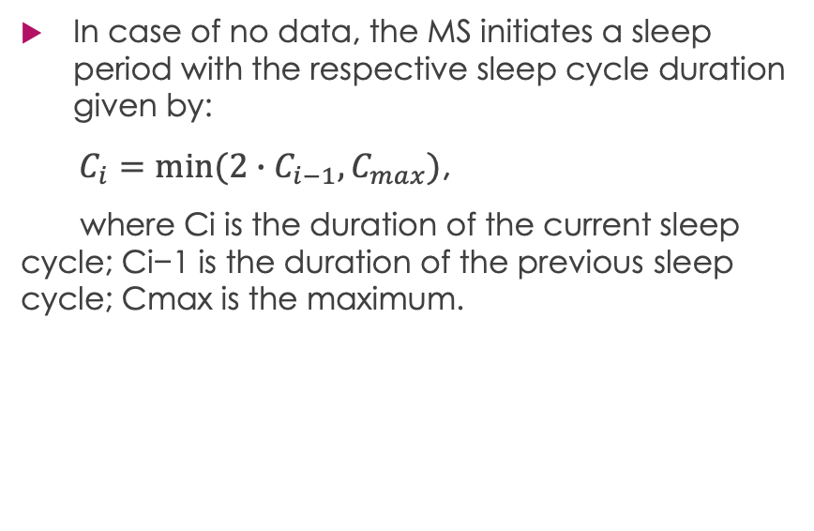
IEEE 802.16m Sleep Mode Operation
In case of no data, the MS initiates a sleep period with the respective sleep cycle duration given by:
$C_{i}=min(2∙C_{i−1}, C_{max})$,
where Ci is the duration of the current sleep cycle; Ci−1 is the duration of the previous sleep cycle; Cmax is the maximum.
The sleep mode operation

Slide 6
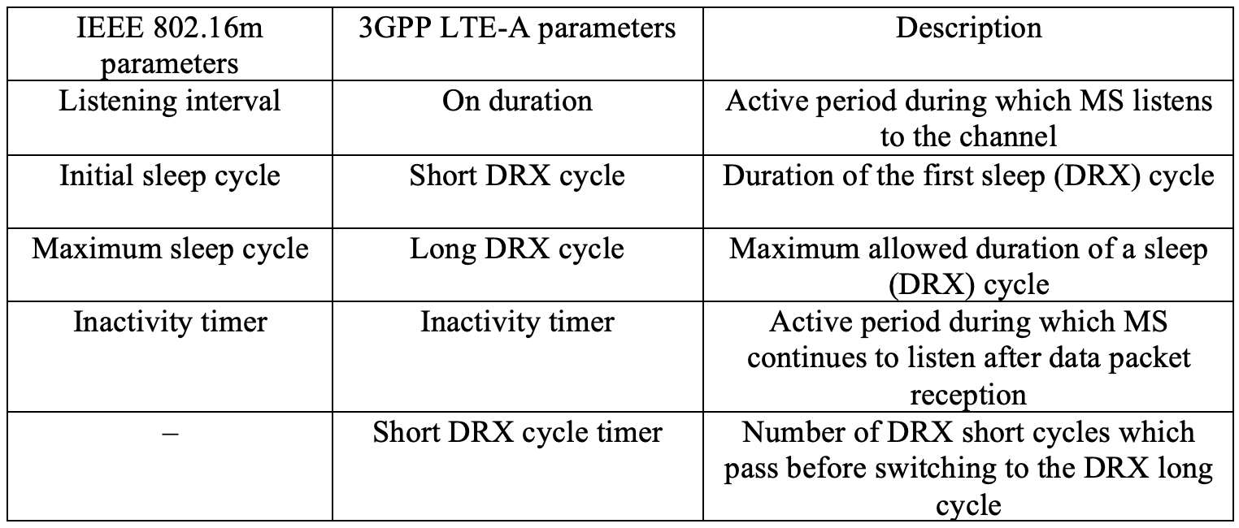
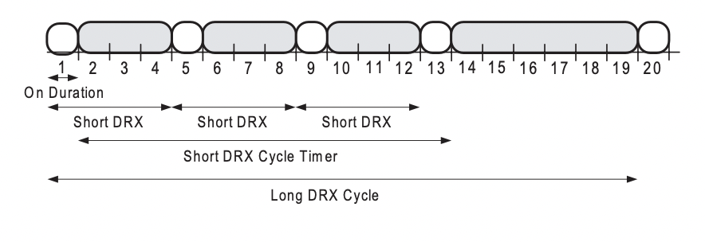
3GPP LTE-Advanced DRX Mode Operation
In particular, an MS listens to the channel activity periodically to save some of its power. However, 3GPP LTE-Advanced defines an alternative mechanism to control the listening intervals.
Parameters of the power saving modes
The DRX mode operation

Slide 7
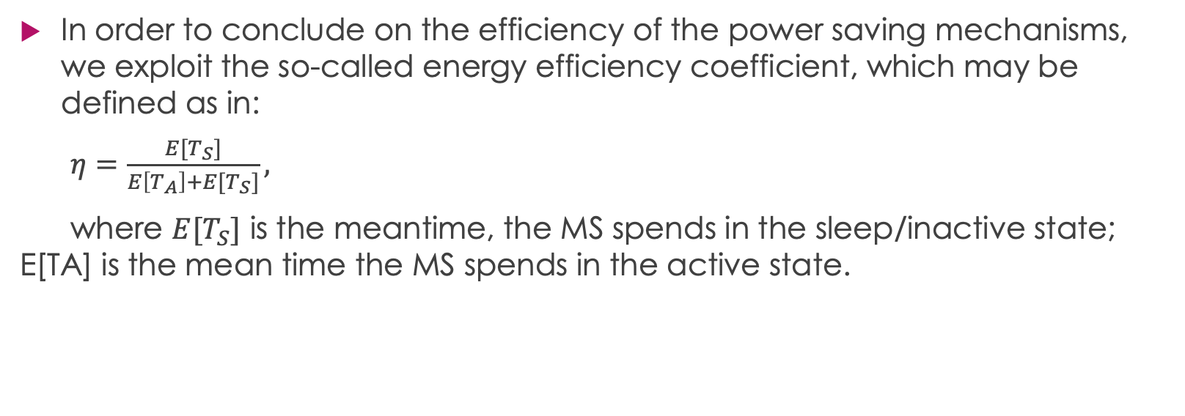
Power Saving Analysis
In order to conclude on the efficiency of the power saving mechanisms, we exploit the so-called energy efficiency coefficient, which may be defined as in:
$η=\frac{E[T_{S}]}{E\left[T_{A}\right]+E[T_{S}]},$
where $E[T_{S}]$ is the meantime, the MS spends in the sleep/inactive state; E[TA] is the mean time the MS spends in the active state.

Slide 8
Experiments

Slide 9
Model Assumptions
Below we introduce a wireless system model in order to assess the performance of the power saving mechanisms. The assumptions of the model may be summarized as follows:
System topology comprises
Only downlink channel is considered.
During a frame, the MS may receive at most one data packet.
Data packets are served by the BS in the order of their arrival
If a packet arrives at the BS during the frame k, it may be sent to the MS not earlier than in the following frame k+1.
Data packet errors are not considered.

Slide 10
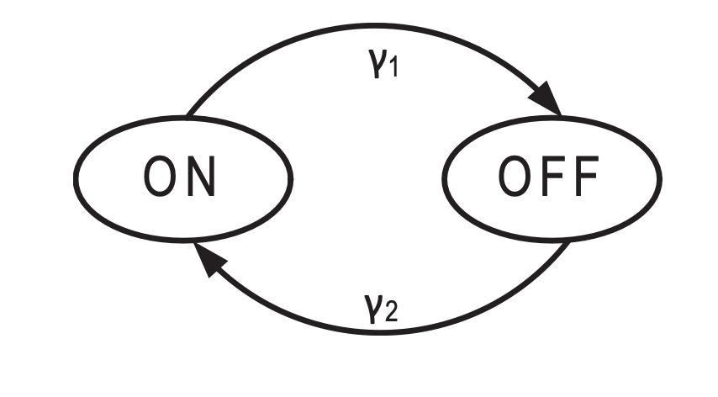
Traffic Arrival Patterns
Both packet arrival flows belong to ON-OFF models, where each model has two states: an active (ON) state and a passive (OFF) state. If a model is currently in the ON state, it generates new data packets. Otherwise, in the OFF state there are no new arrivals.
Example of an ON-OFF model

Slide 11
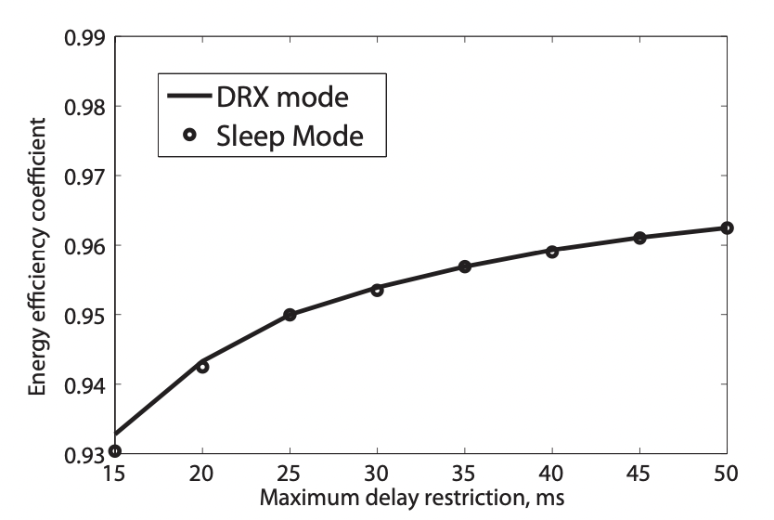
Comparison of Power Saving Modes for VOIP
In order to reduce the complexity of the considered optimization problem, we set the listening period, as well as the inactivity timer equal to one frame (1ms). We plot the energy efficiency coefficient against the maximum packet delay restriction.
Energy coefficient for VoIP

Slide 12
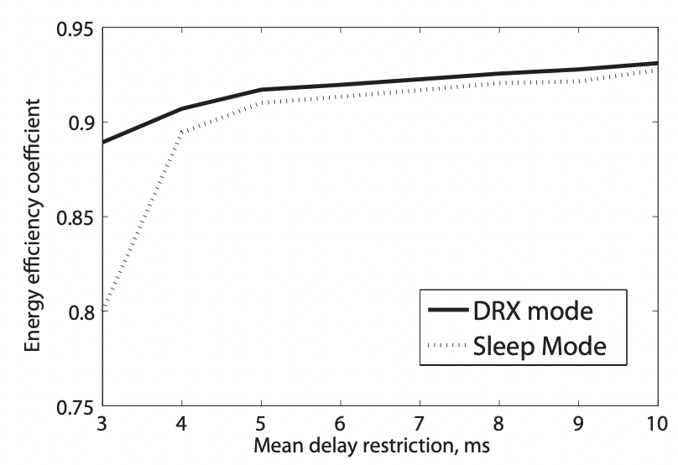
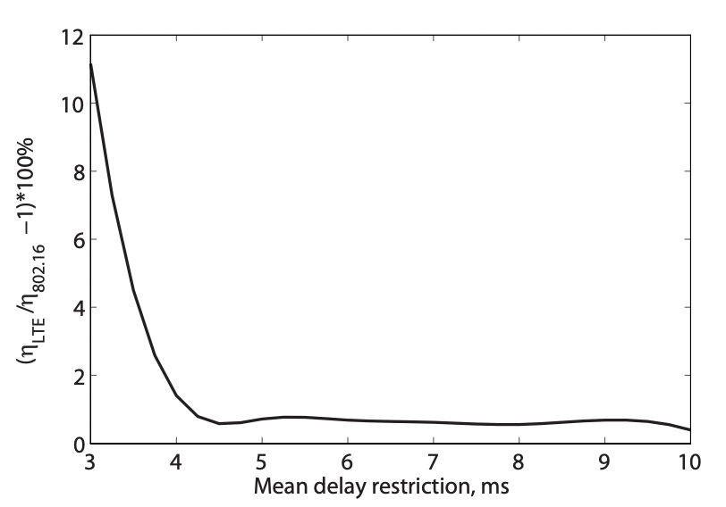
Comparison of Power Saving Modes for HTTP
We plot the energy efficiency coefficient against the mean packet delay restriction for HTTP traffic. We notice that as the mean delay restriction increases, the energy efficiency coefficient grows for both powers saving modes. We demonstrate the gain of the DRX mode over the sleep mode.
Energy coefficient for HTTP traffic
Energy coefficient gain for HTTP

Slide 13
Discussion

Slide 14
Summary of the results
We conducted performance analysis of two power saving modes defined by next-generation wireless communication standards, IEEE 802.16m and 3GPP LTE- Advanced. In order to conclude on the efficiency of the considered mechanisms, we developed a comprehensive system model.

Slide 15
Conclusion
Our analysis indicates that the DRX mode and the sleep mode demonstrate similar behavior of the energy efficiency coefficient subject to a particular maximum packet delay restriction. The DRX mode outperforms the sleep mode in terms of the energy efficiency coefficient for tight mean packet delay restriction. Nevertheless, the performance gain of the DRX mode over the sleep mode drops dramatically for higher values of the mean packet delay restriction.

Slide 16
Thank you for attention!

